Slide 1
Convolutional Neural Network
& Architectures
Sungjoon Choi

Slide 2
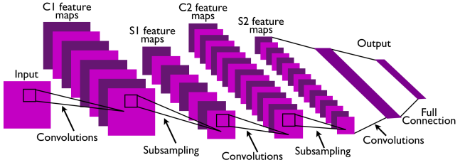
CNN
Convolutional Neural Network
This is pretty much everything about the convolutional neural network.
Convolution + Subsampling + Full Connection

Slide 3

CNN
CNNs are basically layers of convolutions followed by subsampling and dense layers.
Intuitively speaking, convolutions and subsampling layers works as feature extraction layers while a dense layer classifies which category current input belongs to using extracted features.

Slide 4

Convolution
http://deeplearning.stanford.edu/wiki/index.php/Feature_extraction_using_convolution

Slide 5
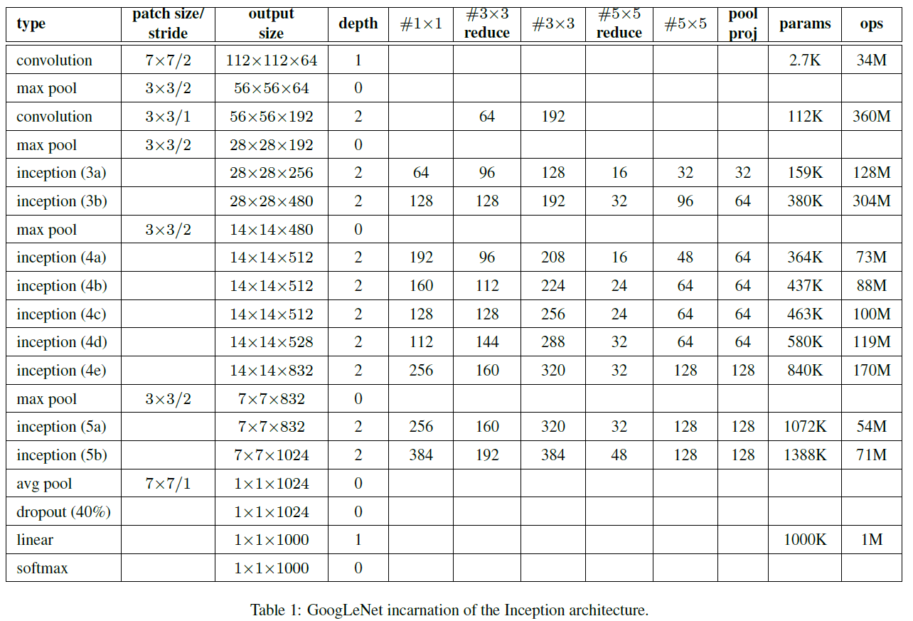

Get familiar with these
Zero-padding
Stride
Channel

Slide 6
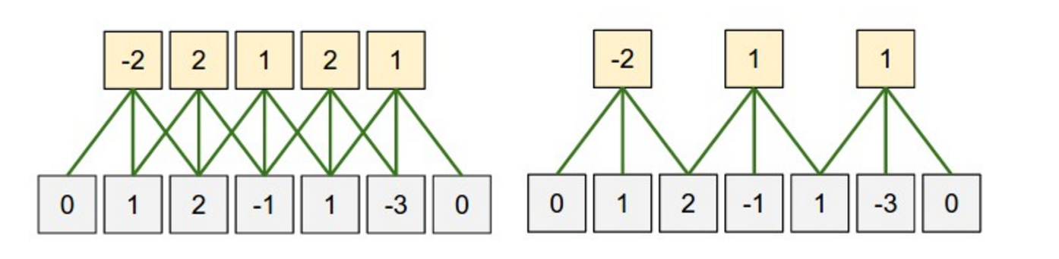
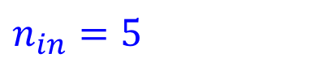
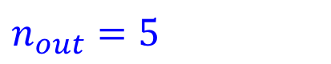
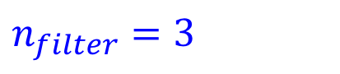
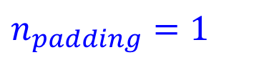
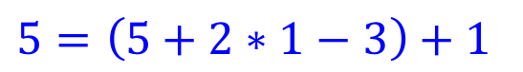
Zero-padding
What is the size of the input?
$n_{in}=5$
What is the size of the output?
$n_{out}=5$
What is the size of the filter?
$n_{filter}=3$
What is the size of the zero-padding?
$n_{padding}=1$
$n_{out}=\left(n_{in}+2∗n_{padding}−n_{filter}\right)+1$
$5=\left(5+2∗1−3\right)+1$

Slide 7
Stride
(Left) Stride size: 1
(Right) Stride size: 2
If stride size equals the filter size, there will be no overlapping.

Slide 8
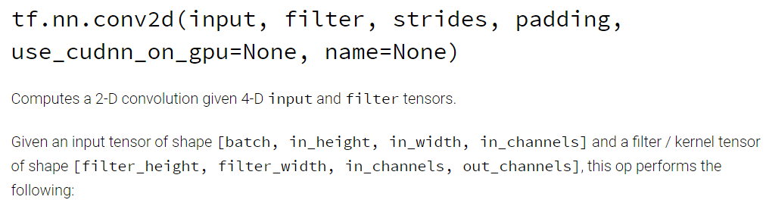
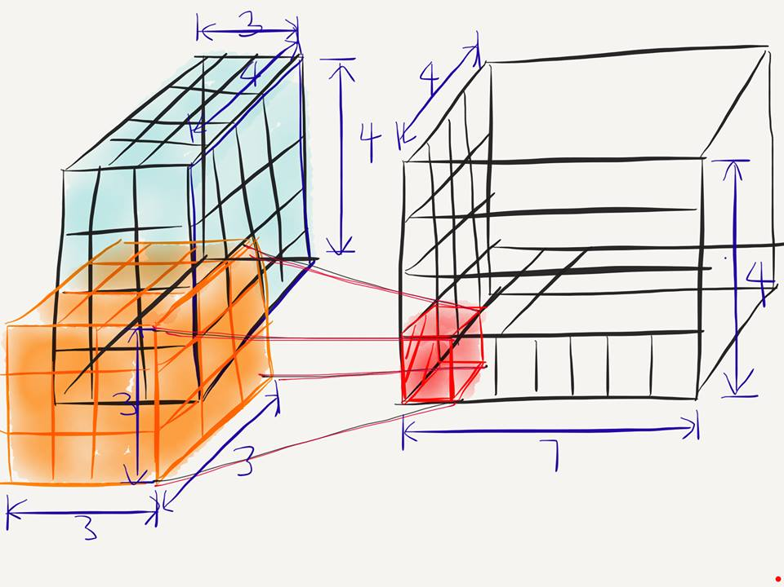
Conv2D
[batch, in_height, in_width, in_chnnel]
[filter_height, filter_width, in_channels, out_channels]
[batch, in_height=4, in_width=4, in_chnnel=3]
[filter_height=3, filter_width=3, in_channels=3, out_channels=7]

Slide 9
Conv2D
[batch, in_height=4, in_width=4, in_chnnel=3]
[filter_height=3, filter_width=3, in_channels=3, out_channels=7]
What is the number of parameters in this convolution layer?
→ $189= 3∗3∗3∗7$

Slide 10
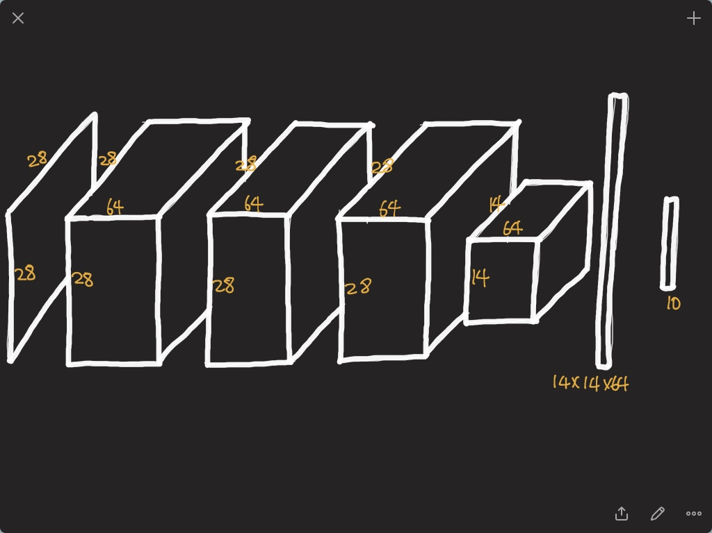

Slide 11
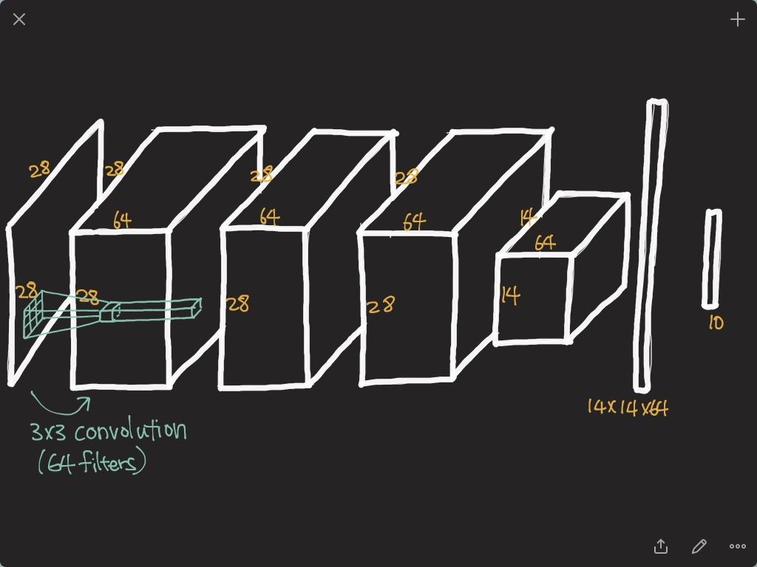

Slide 12
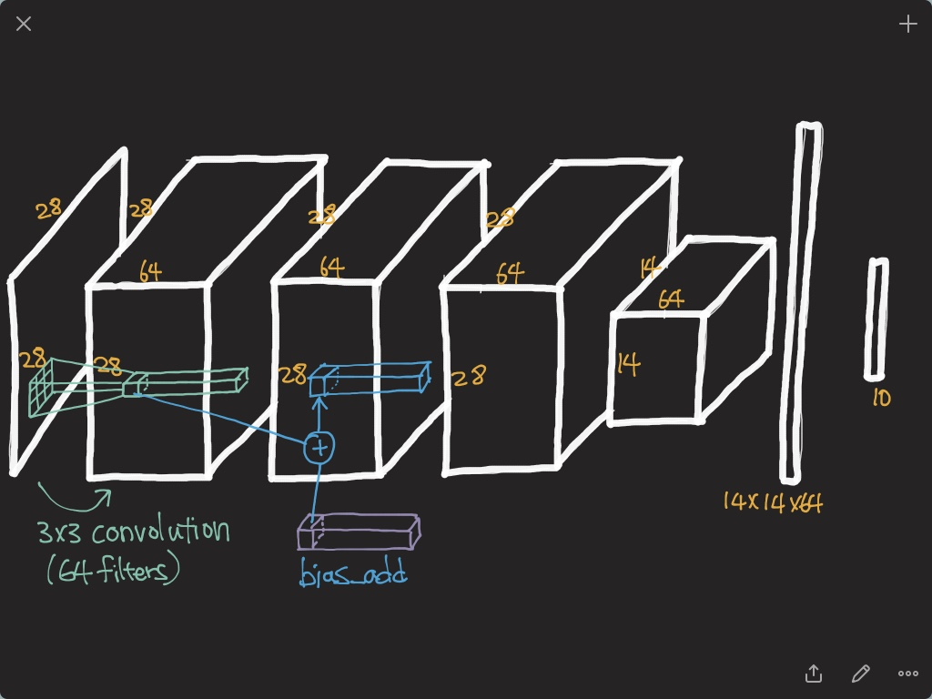

Slide 13
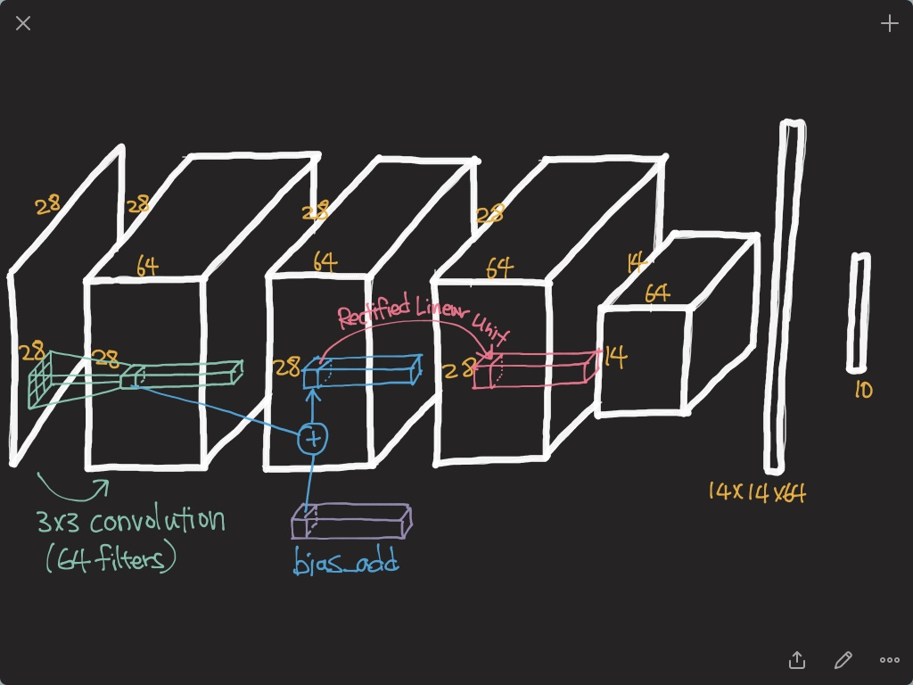

Slide 14
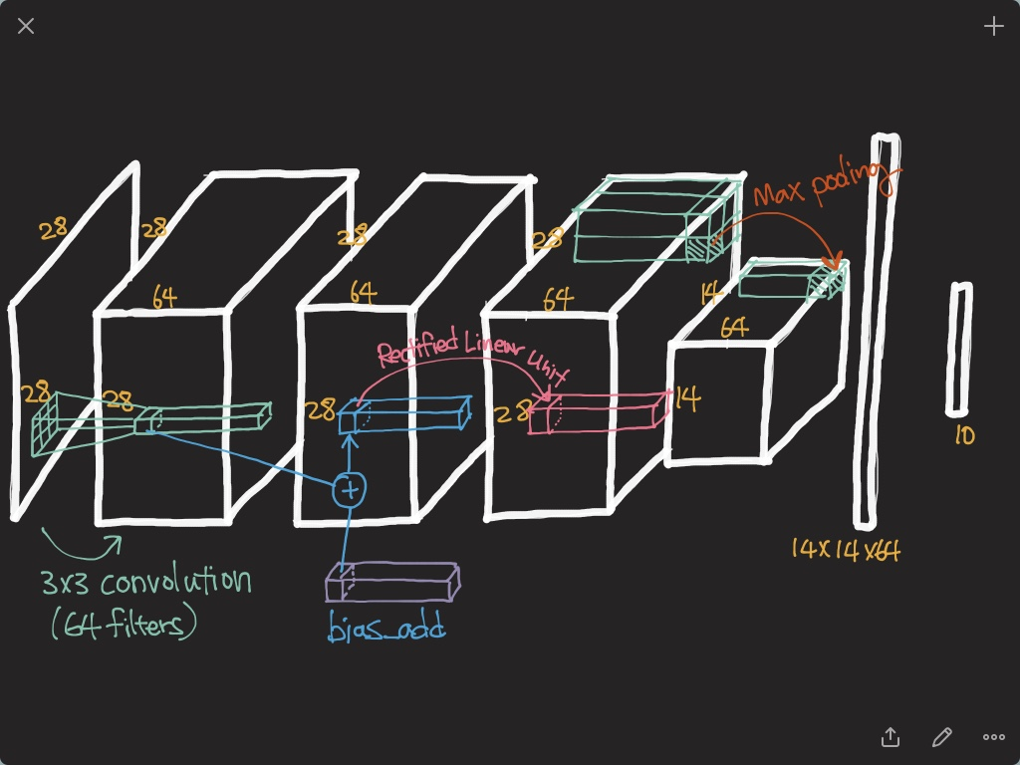

Slide 15
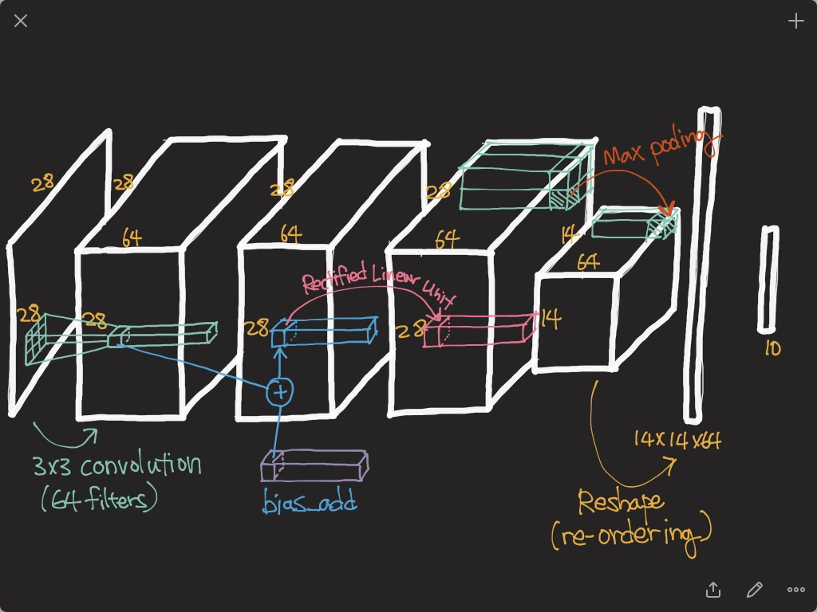

Slide 16
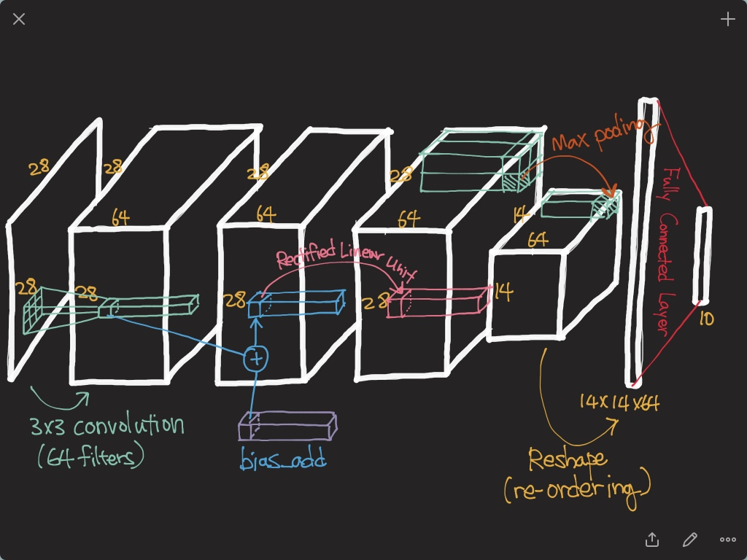

Slide 17
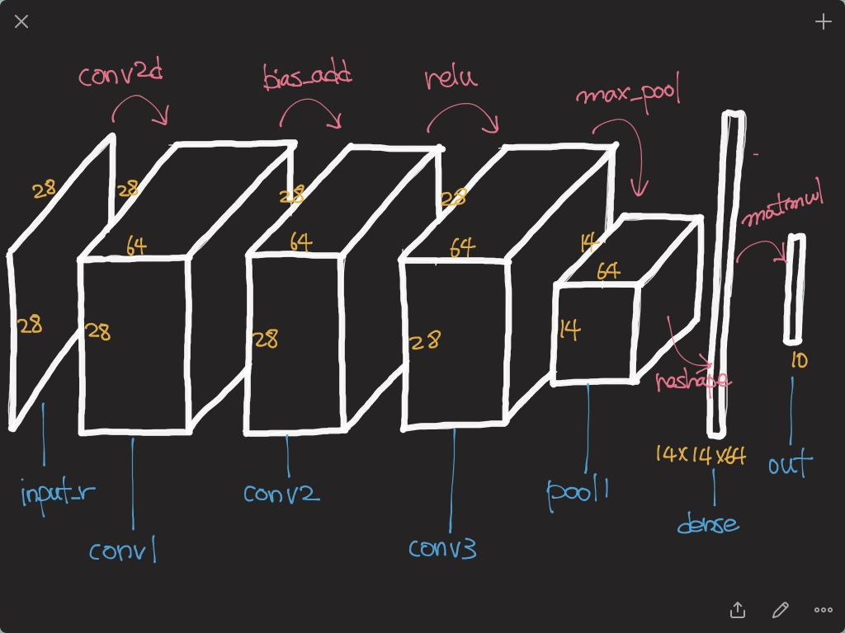

Slide 18
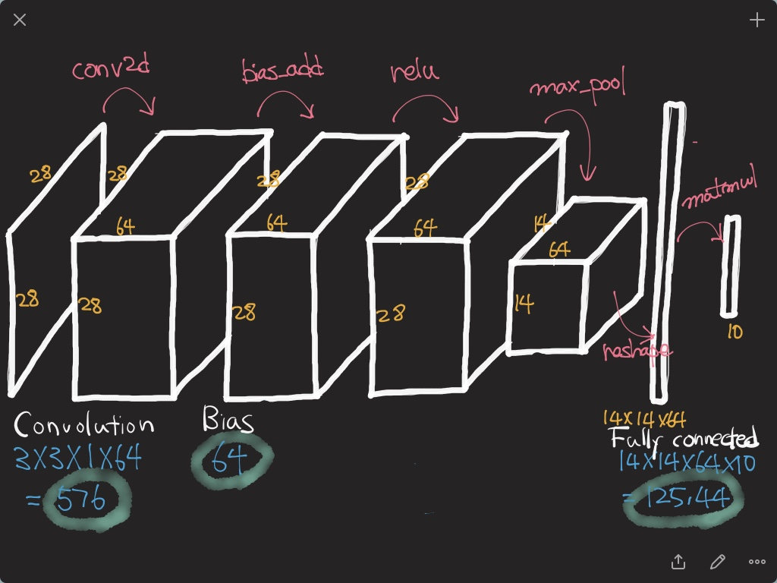

Slide 19
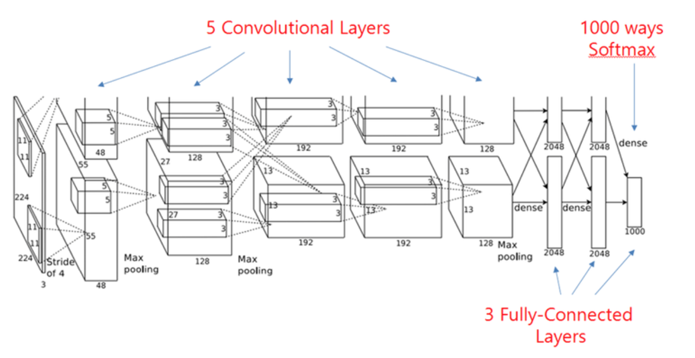
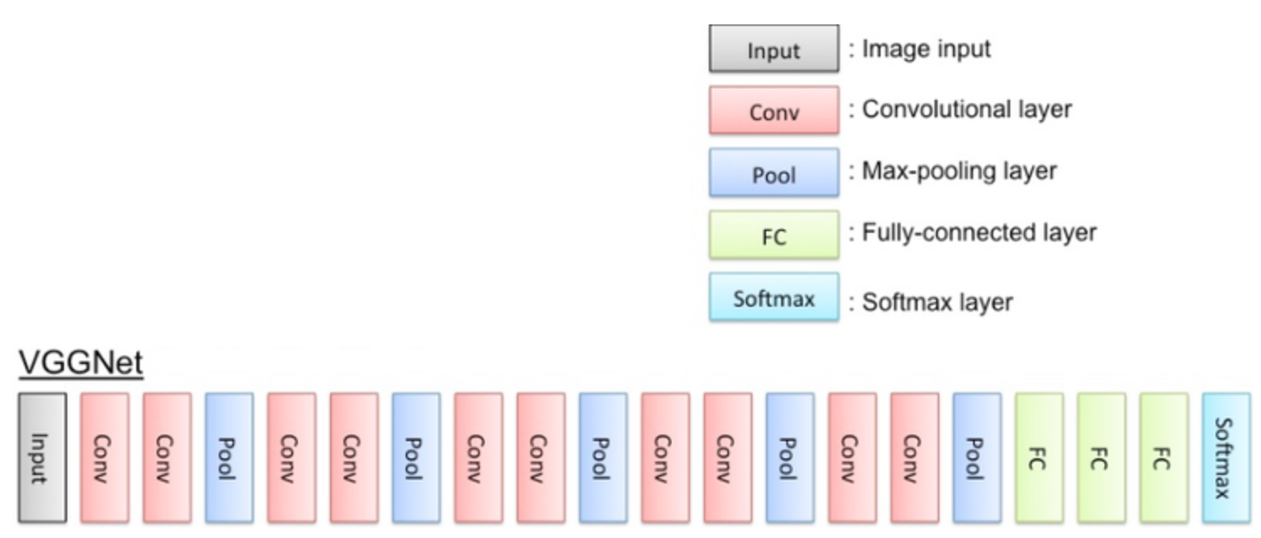
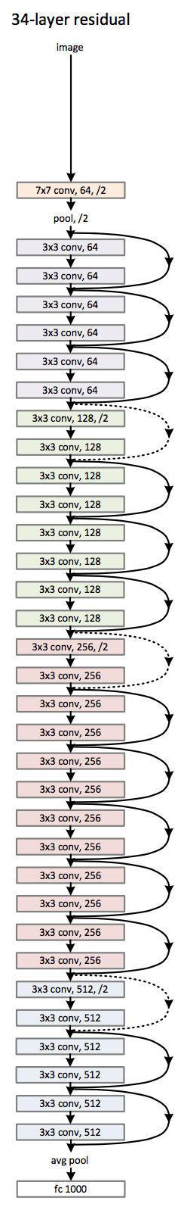
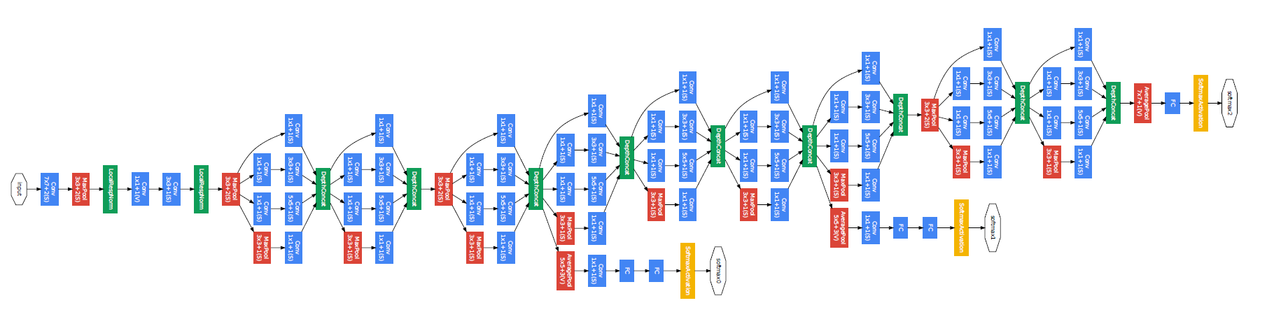
CNN Architectures
AlexNet
VGG
GoogLeNet
ResNet

Slide 20
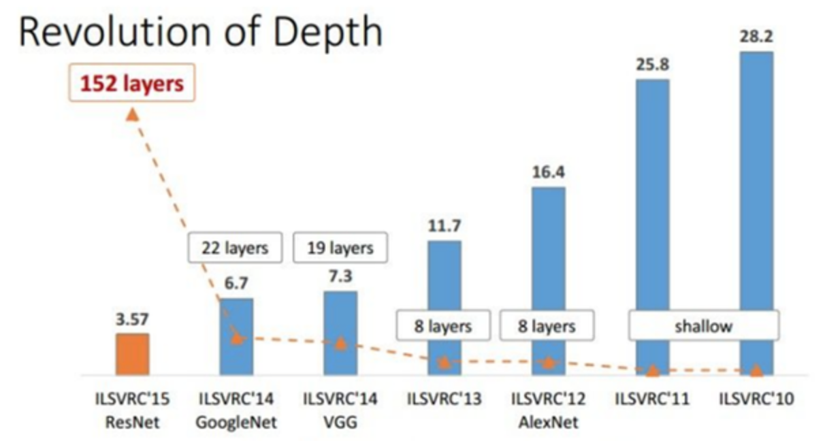
Top-5 Classification Error

Slide 21
AlexNet

Slide 22
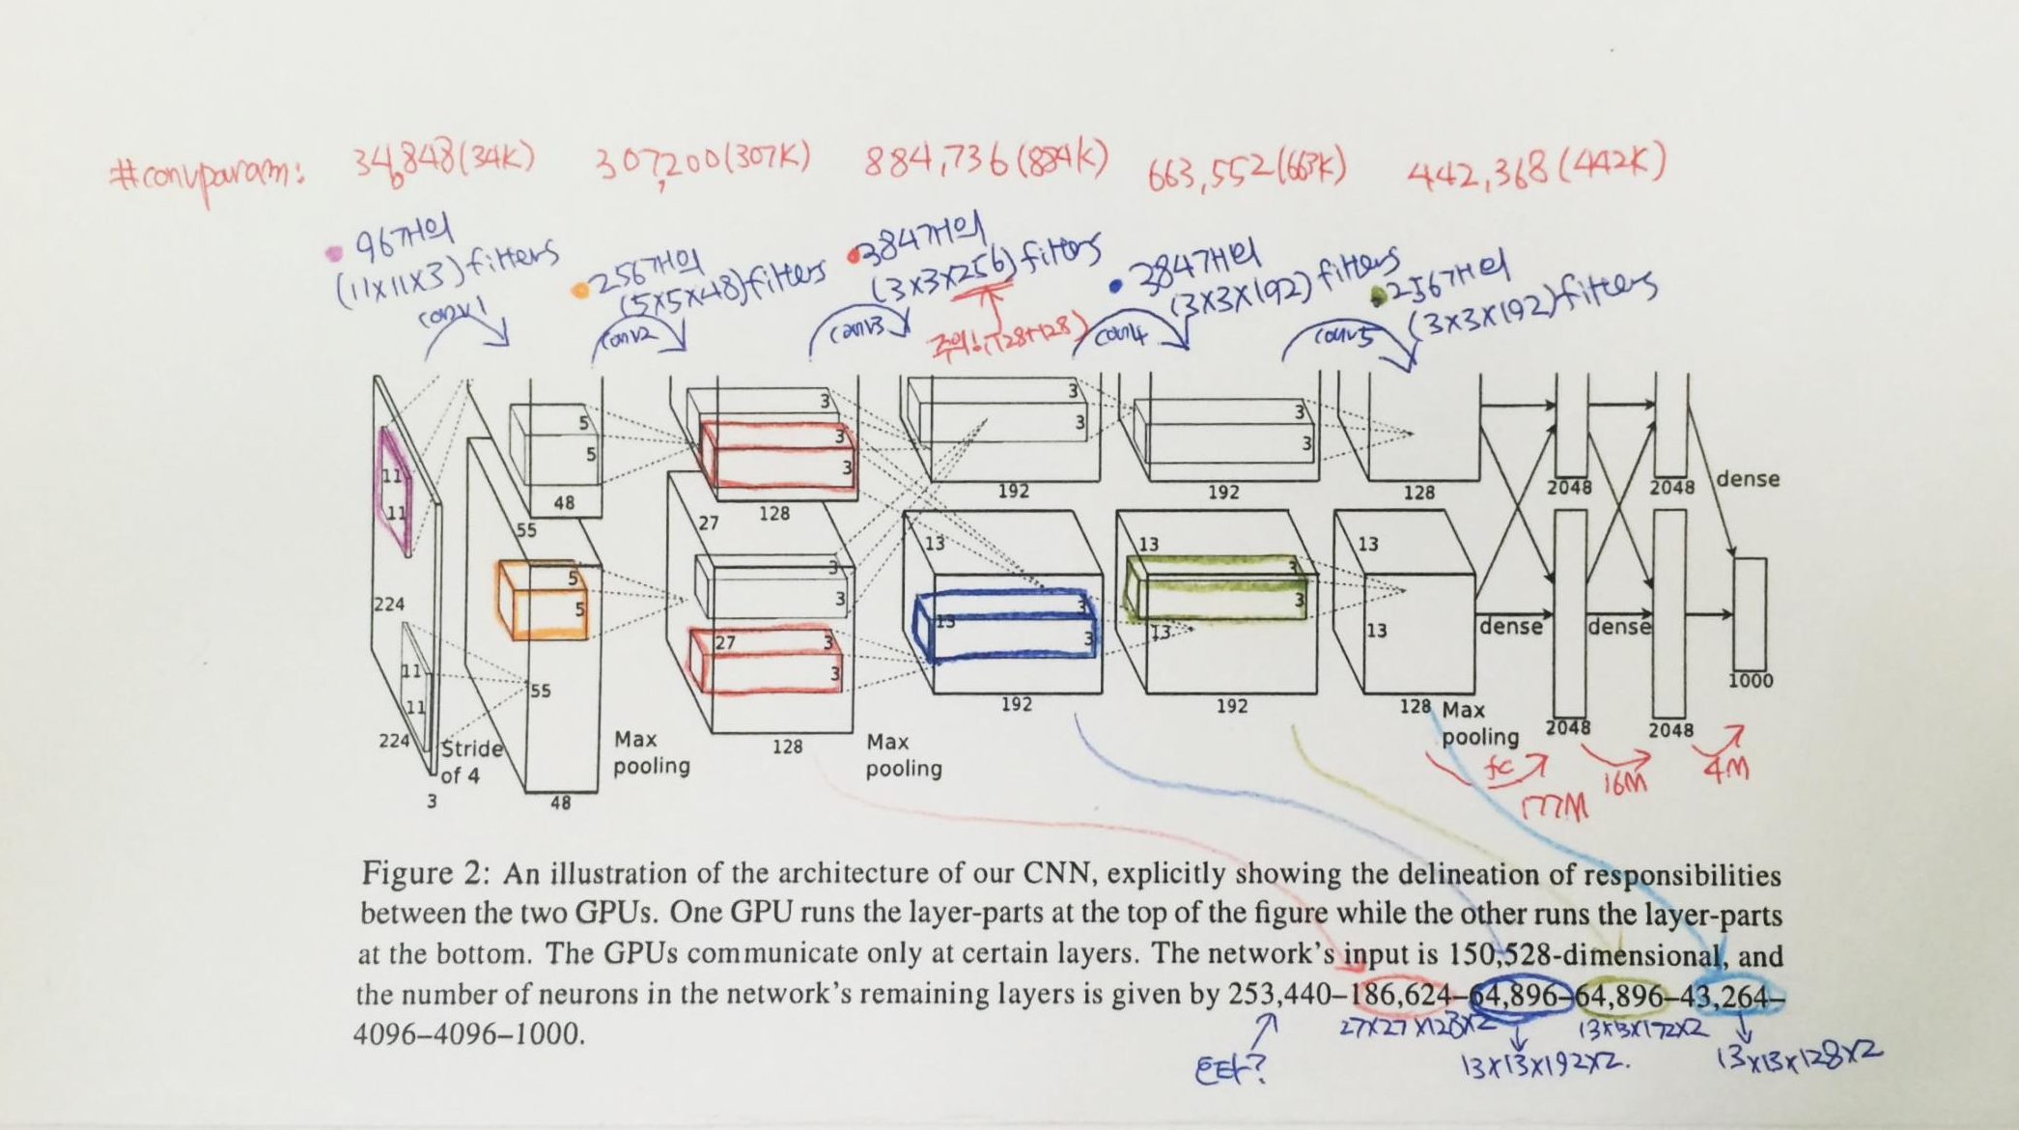
AlexNet

Slide 23
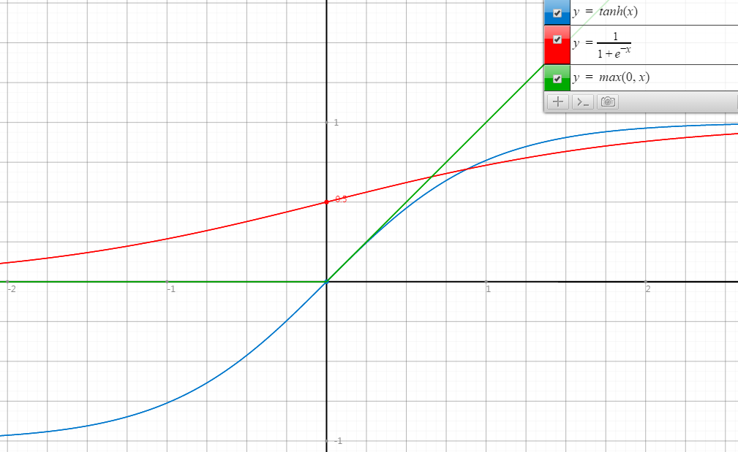
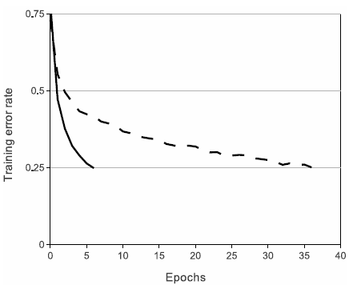
ReLU
Rectified Linear Unit
ReLU
tanh
Faster Convergence!

Slide 24
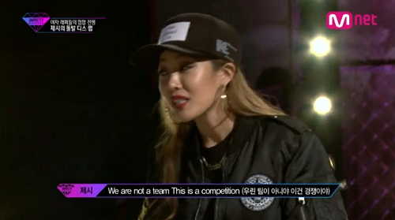
LRN
Local Response Normalization
The response-normalized activity is given by:
$$b_{x,y}^{i}=\frac{a_{x,y}^{i}}{{\left(k+α\sum_{j=\max\left(0, i−n/2\right)}^{\min\left(N−1, i+n/2\right)}{{\left(a_{x,y}^{j}\right)}^{2}}\right)}^{β}}$$
It implements a form of lateral inhibition inspired by real neurons.

Slide 25

Regularization in AlexNet
Main objective is to reduce overfitting.
More details will be handled in next week.
In the AlexNet, two regularization methods are used.
Data augmentation
Dropout

Slide 26
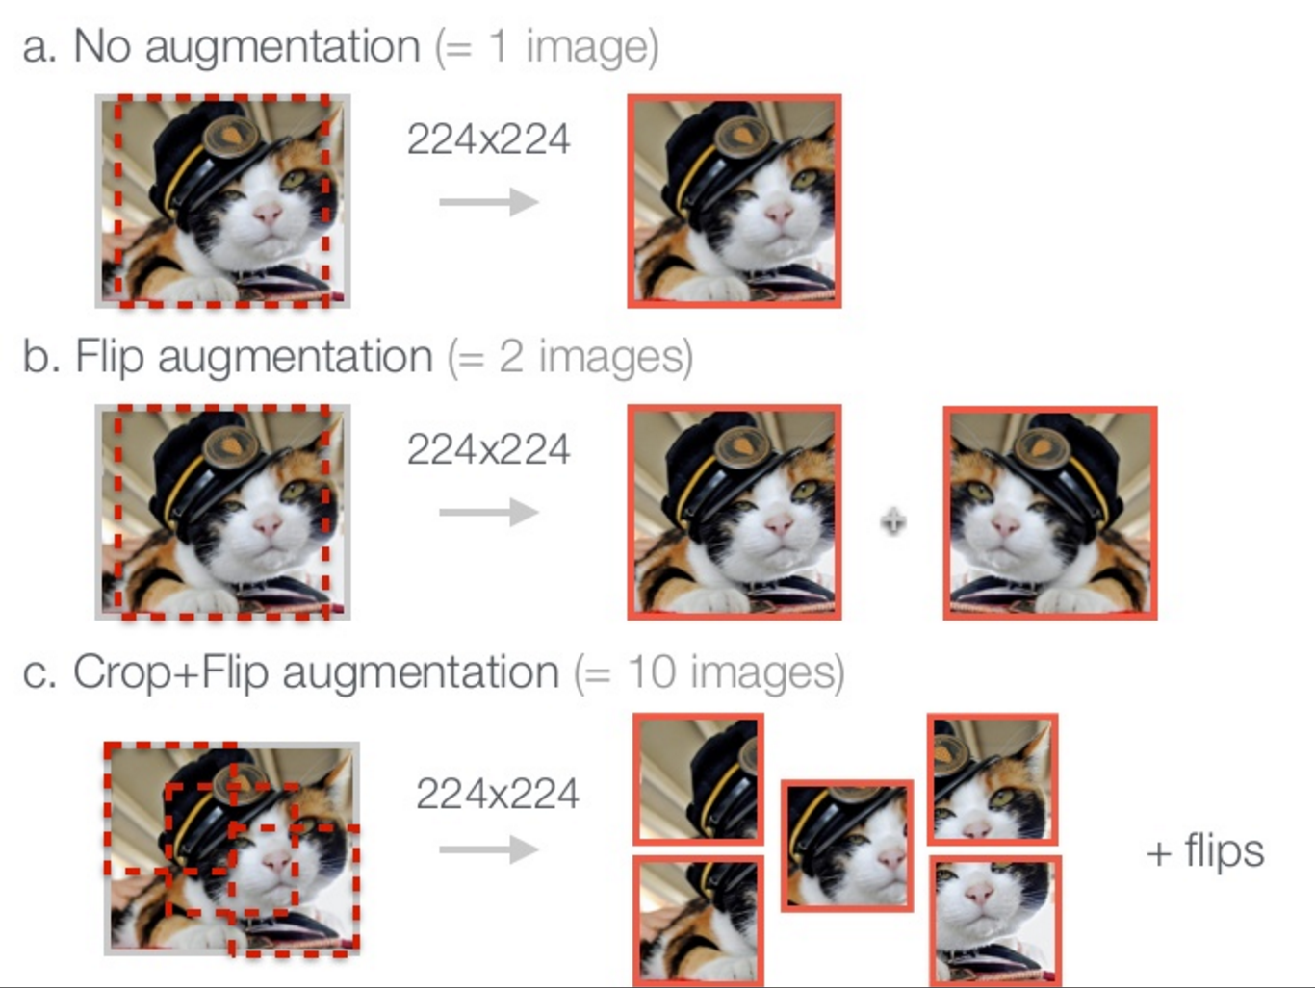
Data augmentation
http://www.slideshare.net/KenChatfield/chatfield14-devil

Slide 27
Data augmentation in AlexNet
Original Image
(256 $×$ 256)
Smaller Patch
(224 $×$ 224)
This increases the size of the training set by a factor of $2048 \left(32∗32∗2\right)$.
Two comes from horizontal reflections.

Slide 28
Data augmentation in AlexNet
Original Patch
(224 $×$ 224)
Altered Patch
(224 $×$ 224)
Color variation
To each RGB image pixel, following quantity is added:
$$\left[p_{1}, p_{2}, p_{3}\right]{\left[α_{1}λ_{1},α_{2}λ_{2},α_{3}λ_{3}\right]}^{T}$$
where $p_{i}$ and $λ_{i}$ are $i$th eigenvector and eigenvalue of $3×3$ covariance matrix of RGB pixel values.
Probabilistically, not a single patch will be same at the training phase! (a factor of infinity!)

Slide 29
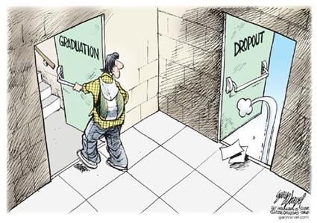
Dropout
Original dropout [1] sets the output of each hidden neuron with certain probability.
In this paper, they simply multiply the outputs by 0.5.
[1] G.E. Hinton, N. Srivastava, A. Krizhevsky, I. Sutskever, and R.R. Salakhutdinov. Improving neural networks by preventing co-adaptation of feature detectors. arXiv, 2012.
http://www.eddyazar.com/the-regrets-of-a-dropout-and-why-you-should-drop-out-too/

Slide 30
VGG

Slide 31
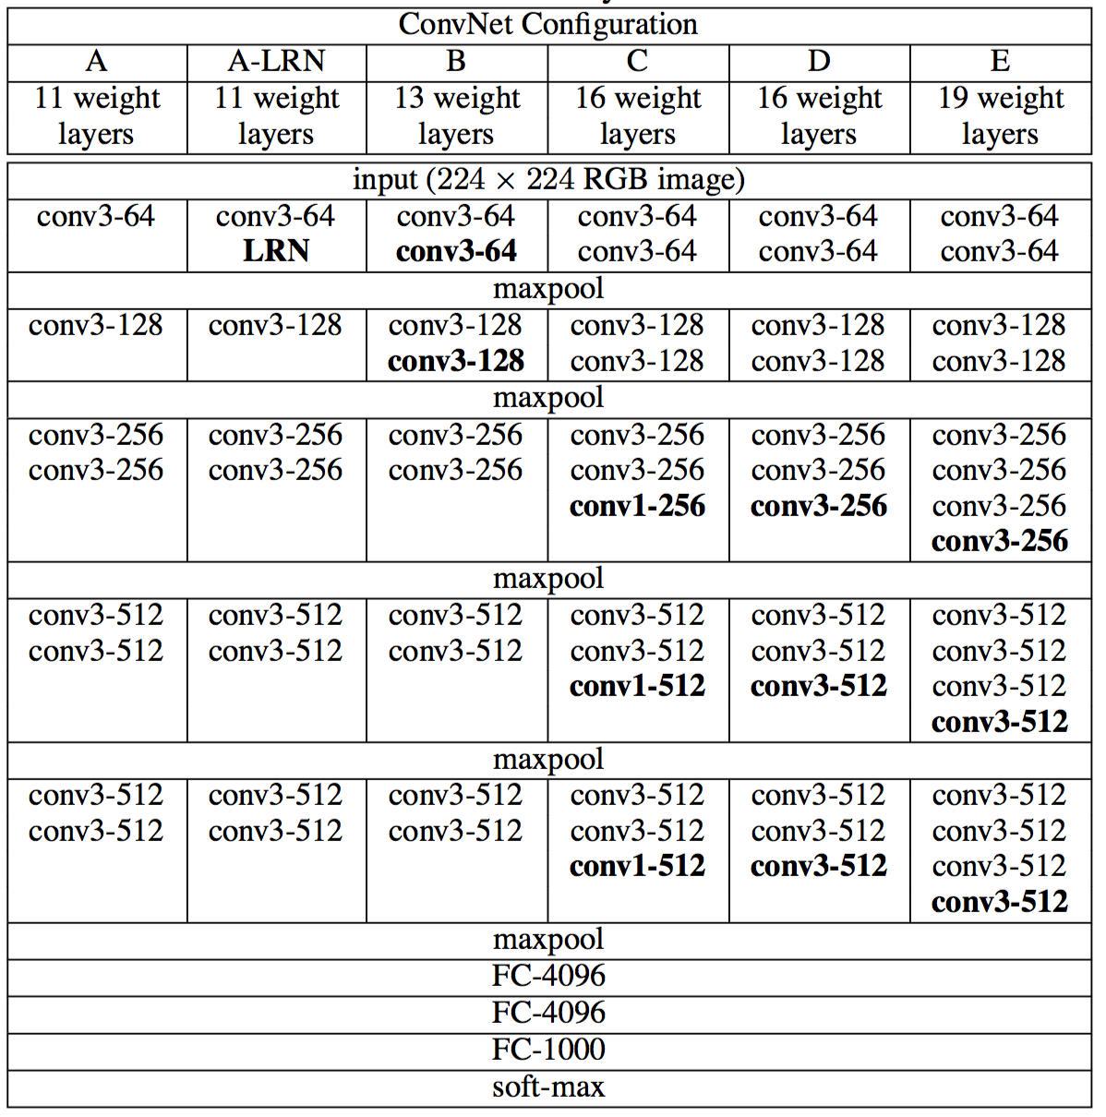
VGG?

Slide 32
GoogLeNet

Slide 33


GoogLeNet

Slide 34
GoogLeNet
22 Layers Deep Network
Efficiently utilized computing resources, “Inception Module”
Significantly outperforms previous methods on ILSVRC 2014

Slide 35
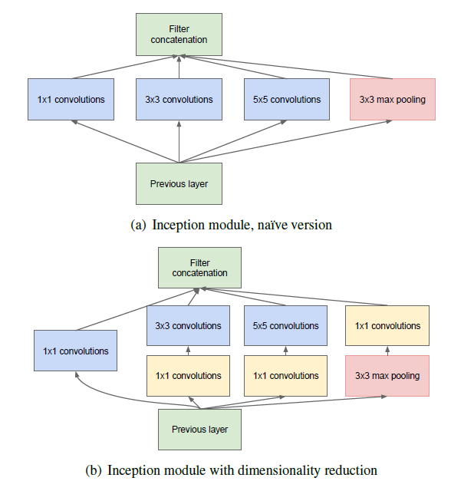
Inception module

Slide 36
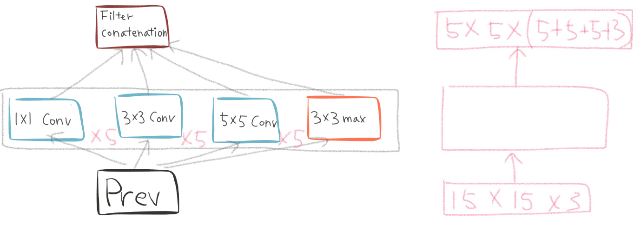
Naïve inception module

Slide 37
Naïve inception module

Slide 38
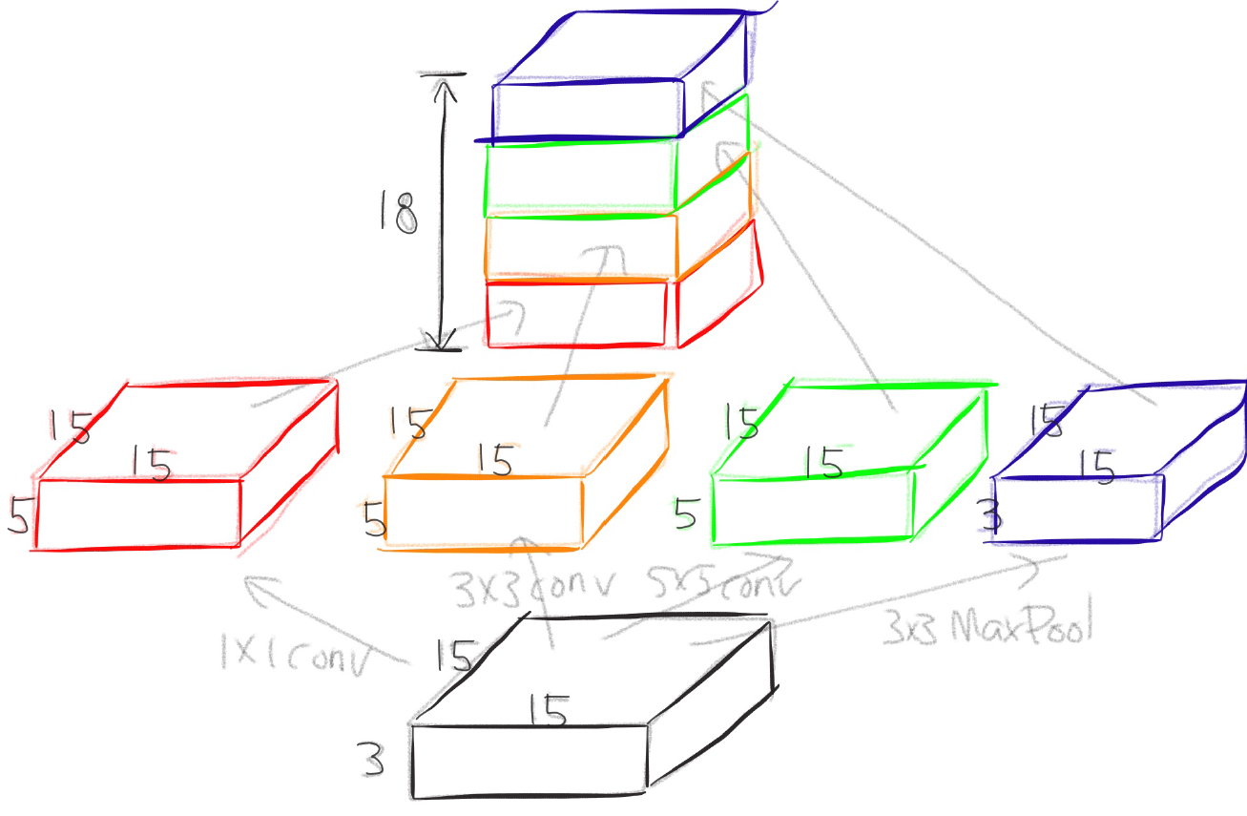
Naïve inception module

Slide 39
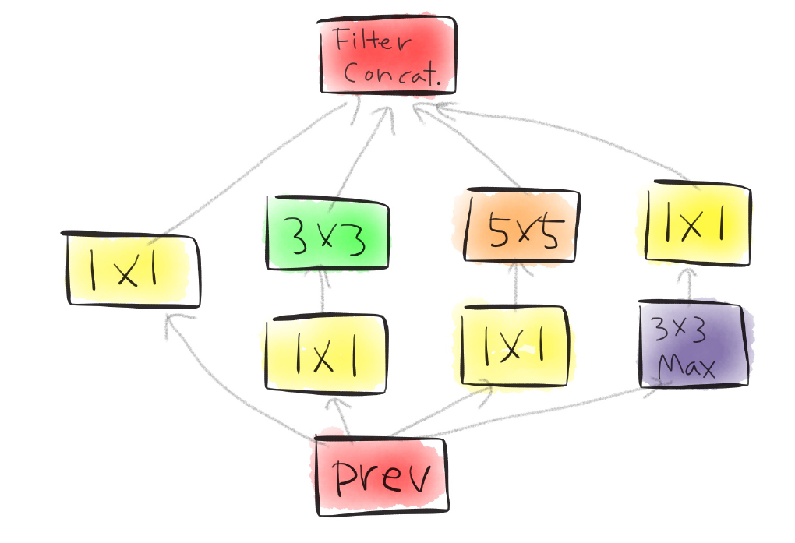
Actual inception module

Slide 40
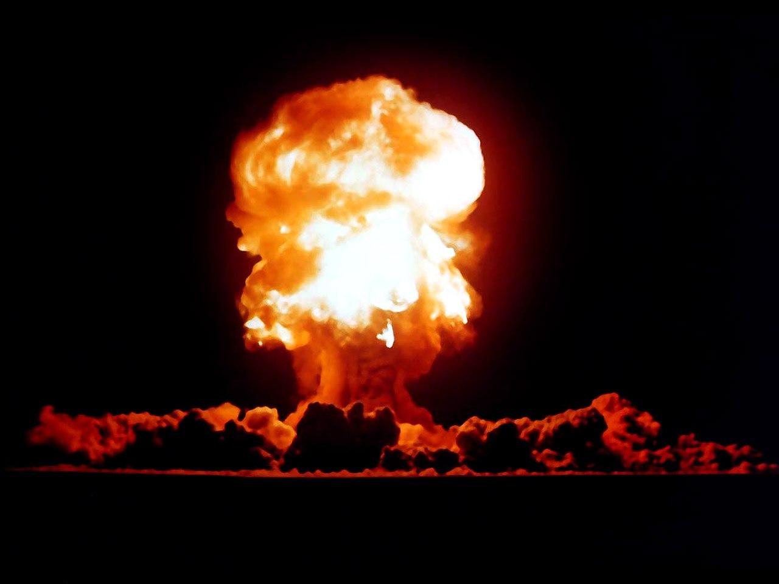
One by one convolution

Slide 41
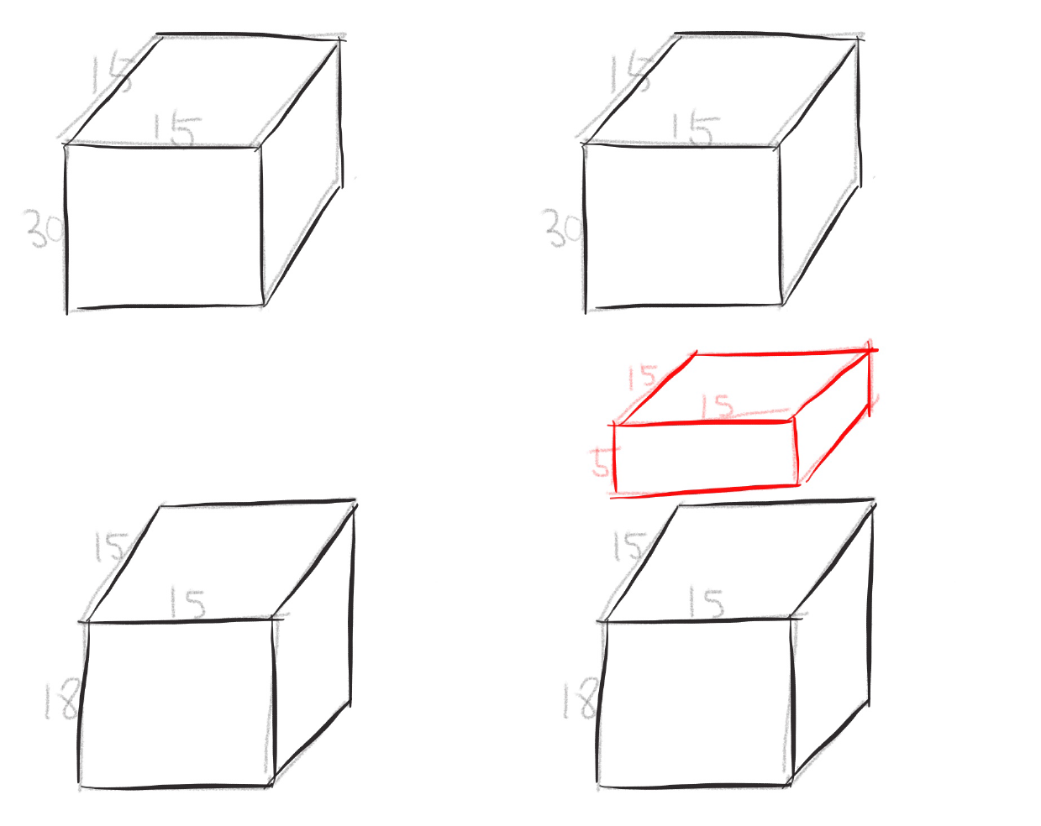
One by one convolution

Slide 42
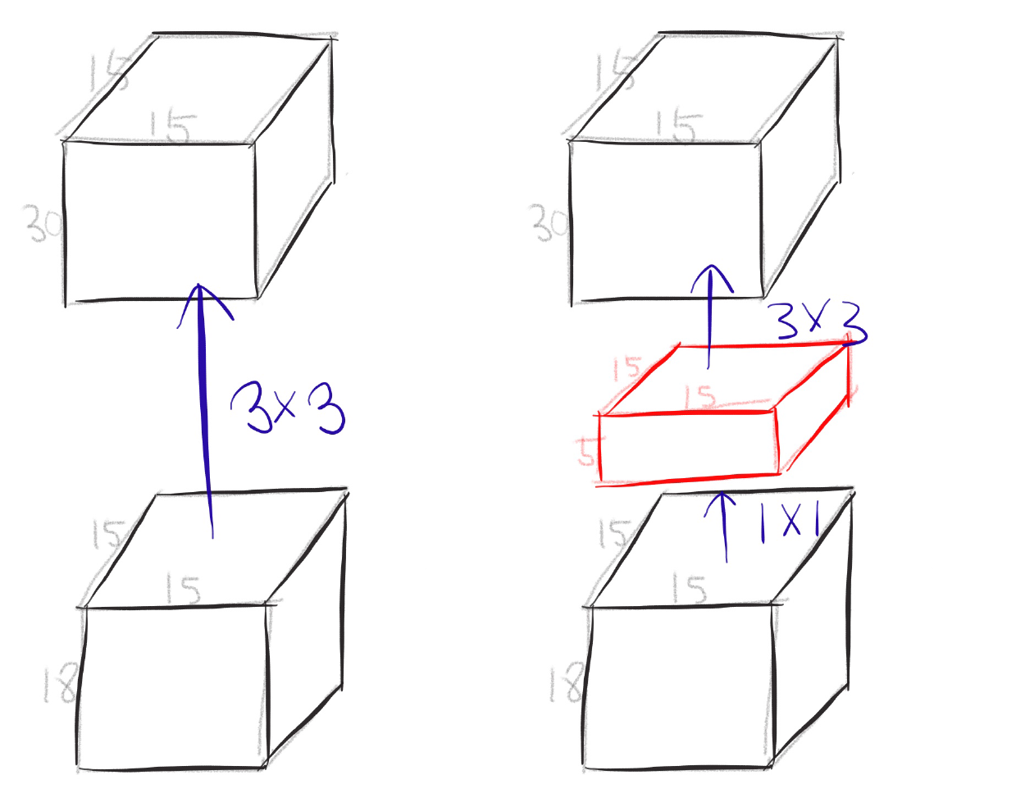
One by one convolution

Slide 43
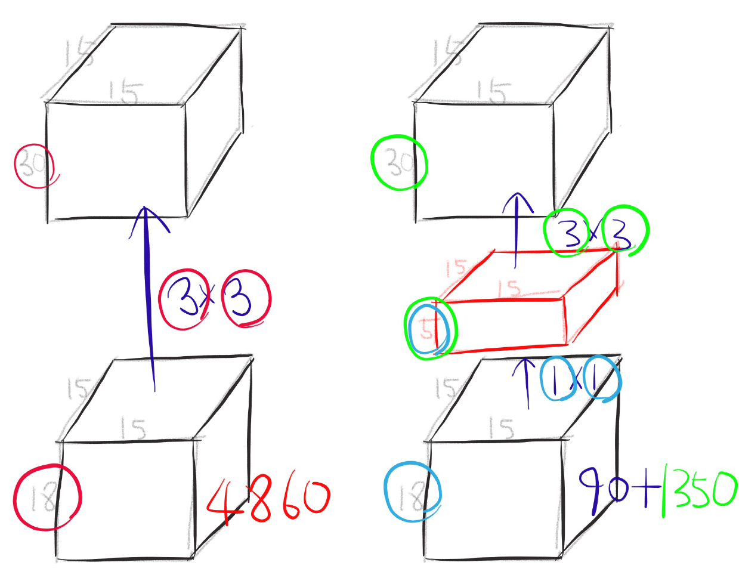
One by one convolution

Slide 44
GoogLeNet
Network in Network!

Slide 45
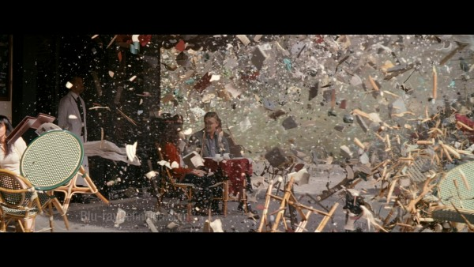
Conclusion
Very clever idea of using one by one convolution for dimension reduction!
Other than that...

Slide 46
Inception-v4, Inception-ResNet and the Impact of Residual Connections on Learning

Slide 47
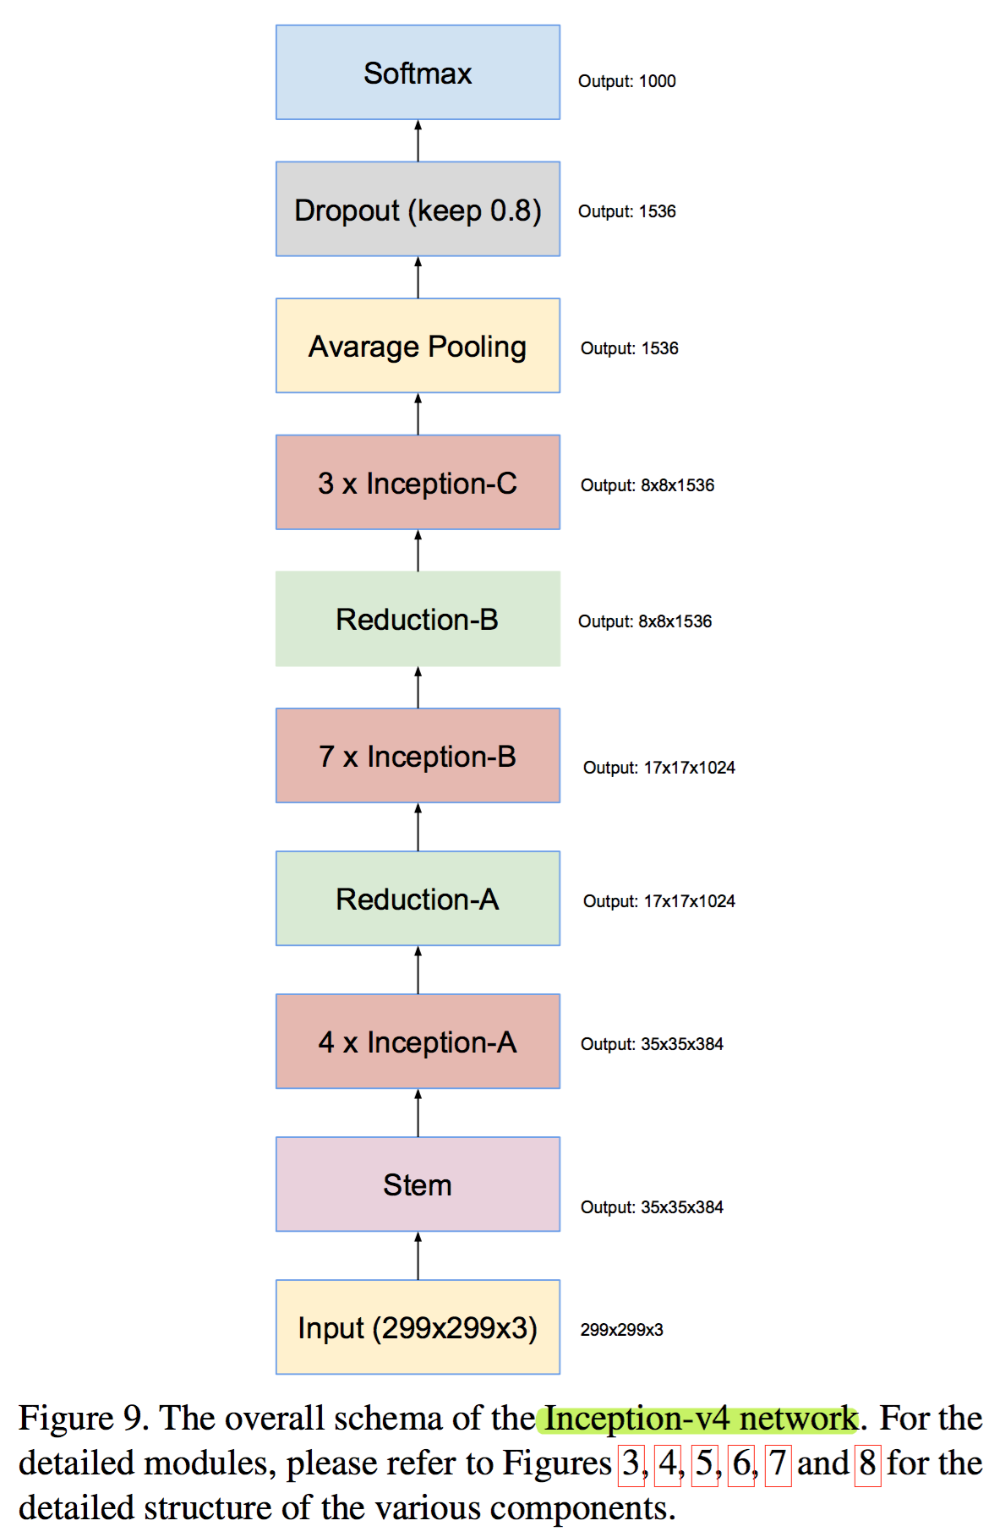
Residual inception blocks

Slide 48
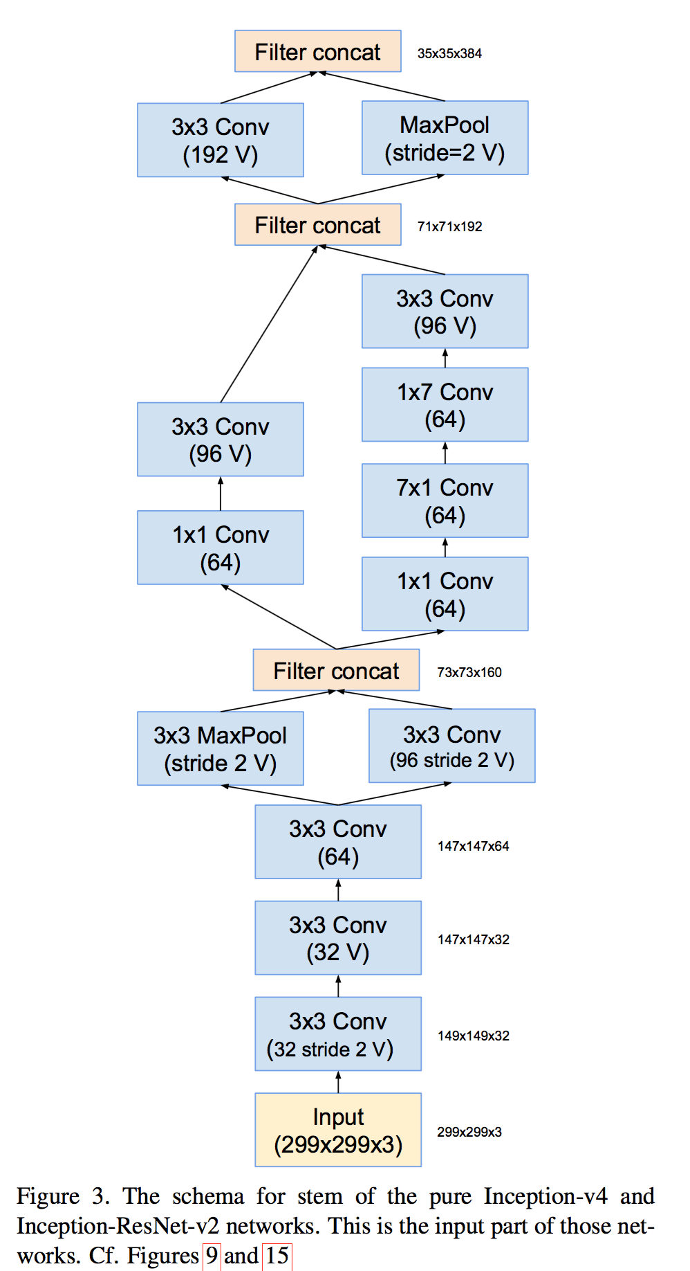
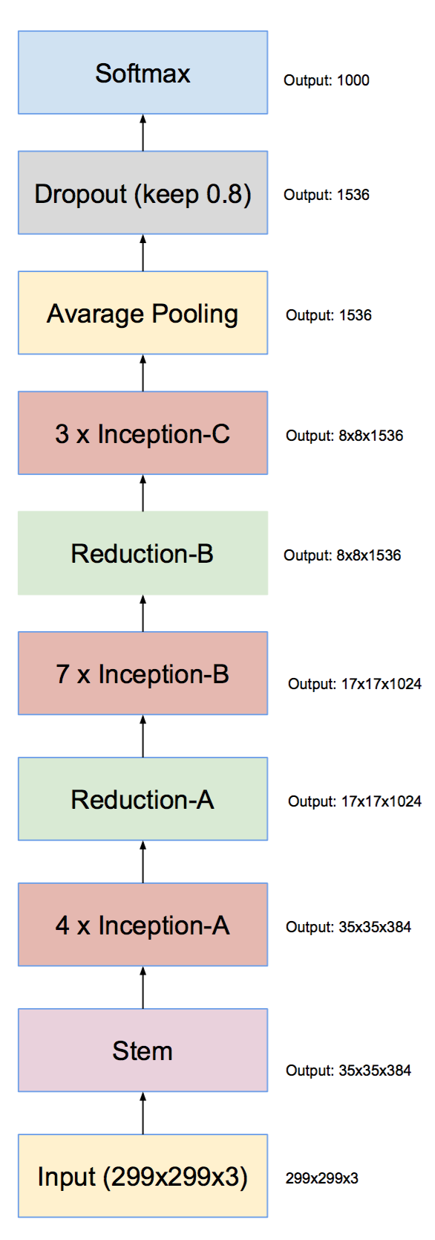
Inception v4

Slide 49
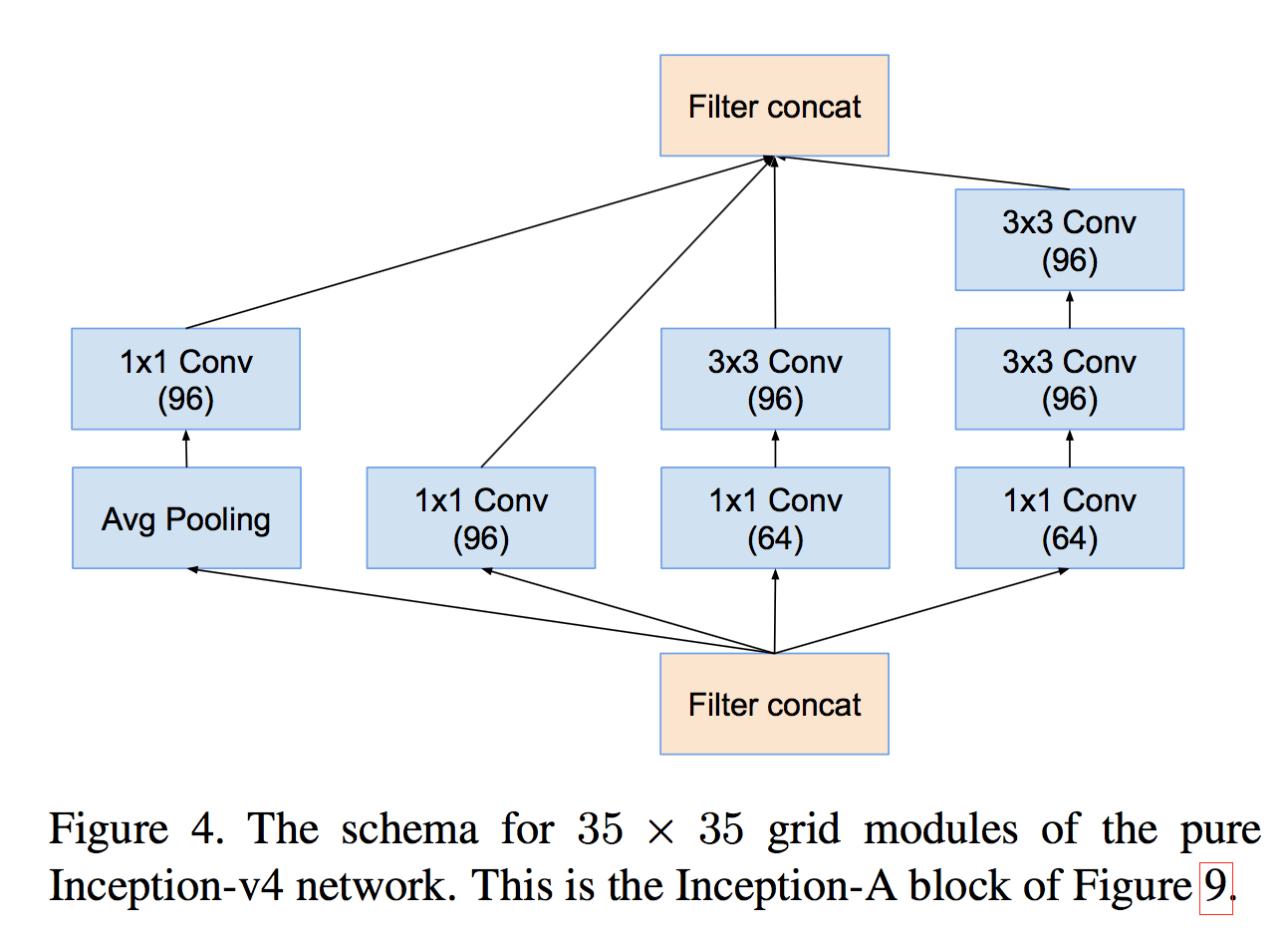
Inception v4

Slide 50
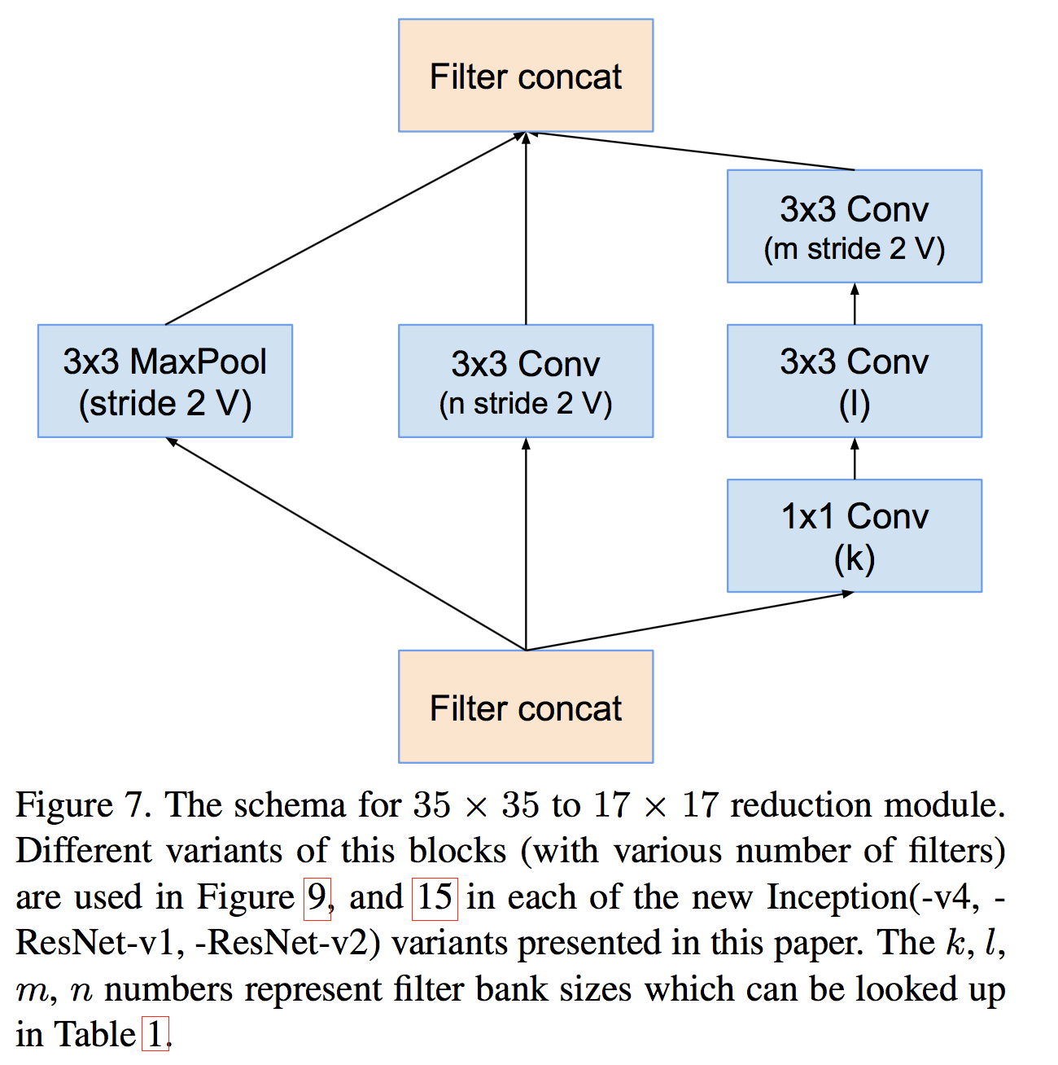
Inception v4

Slide 51
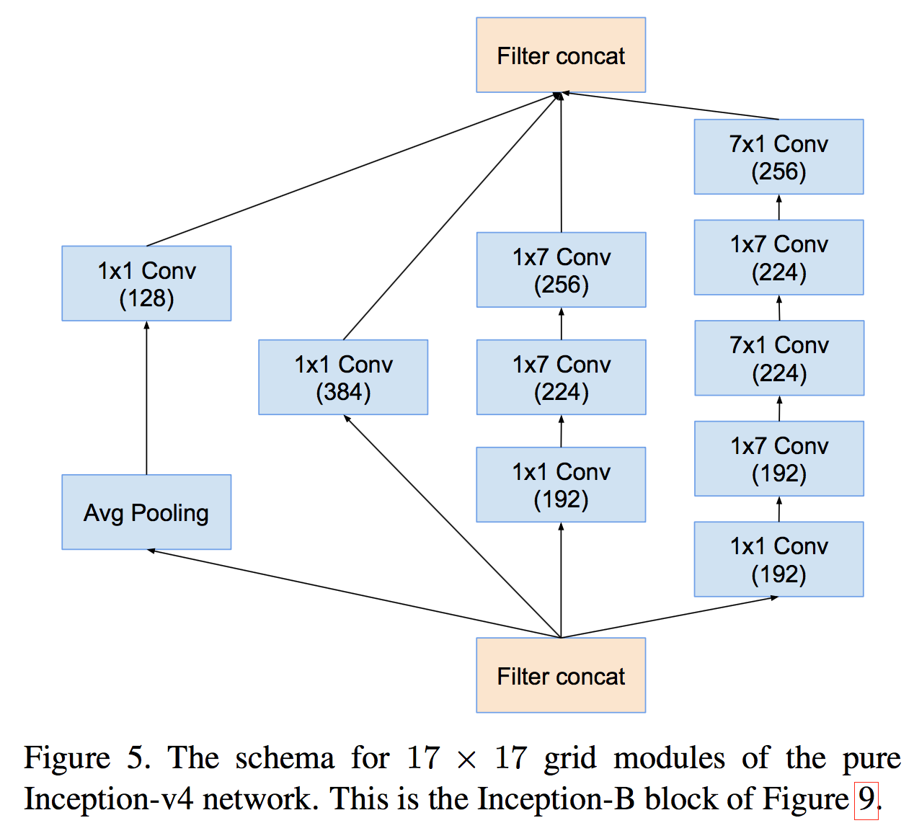
Inception v4

Slide 52
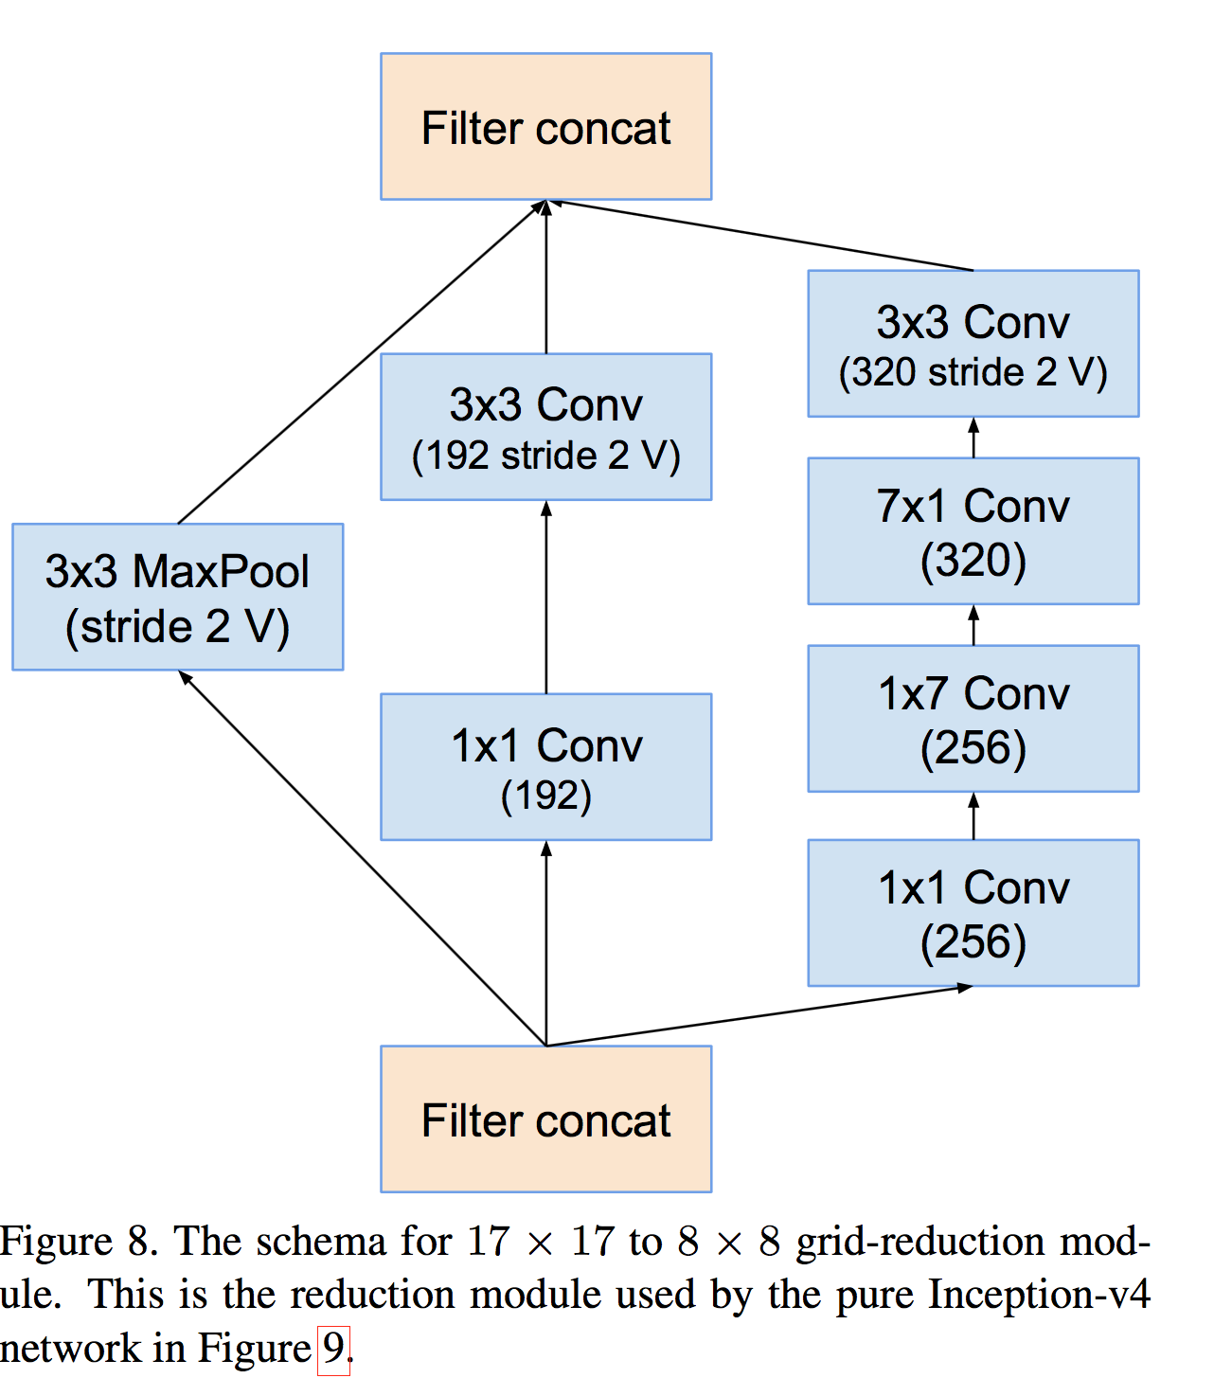
Inception v4

Slide 53
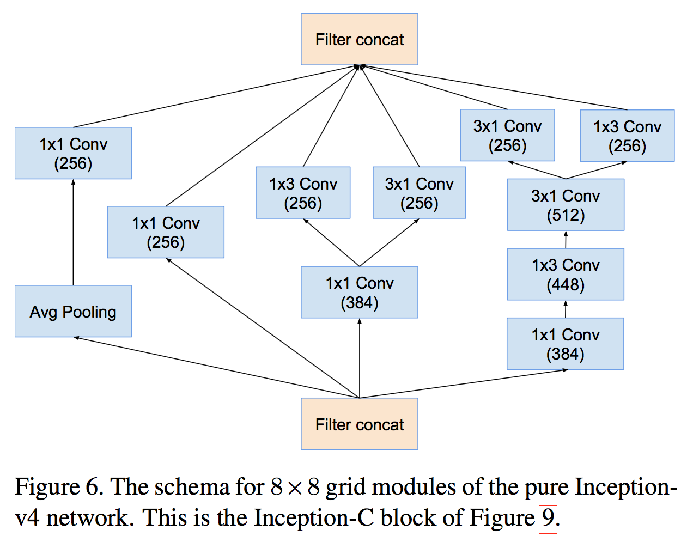
Inception v4

Slide 54
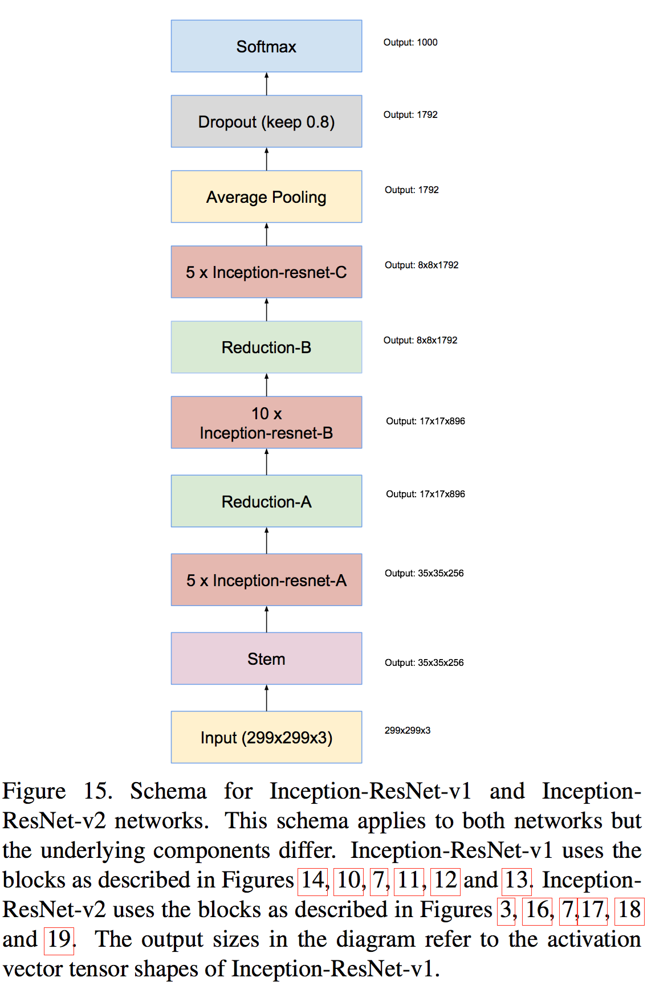
Inception-ResNet-v1

Slide 55
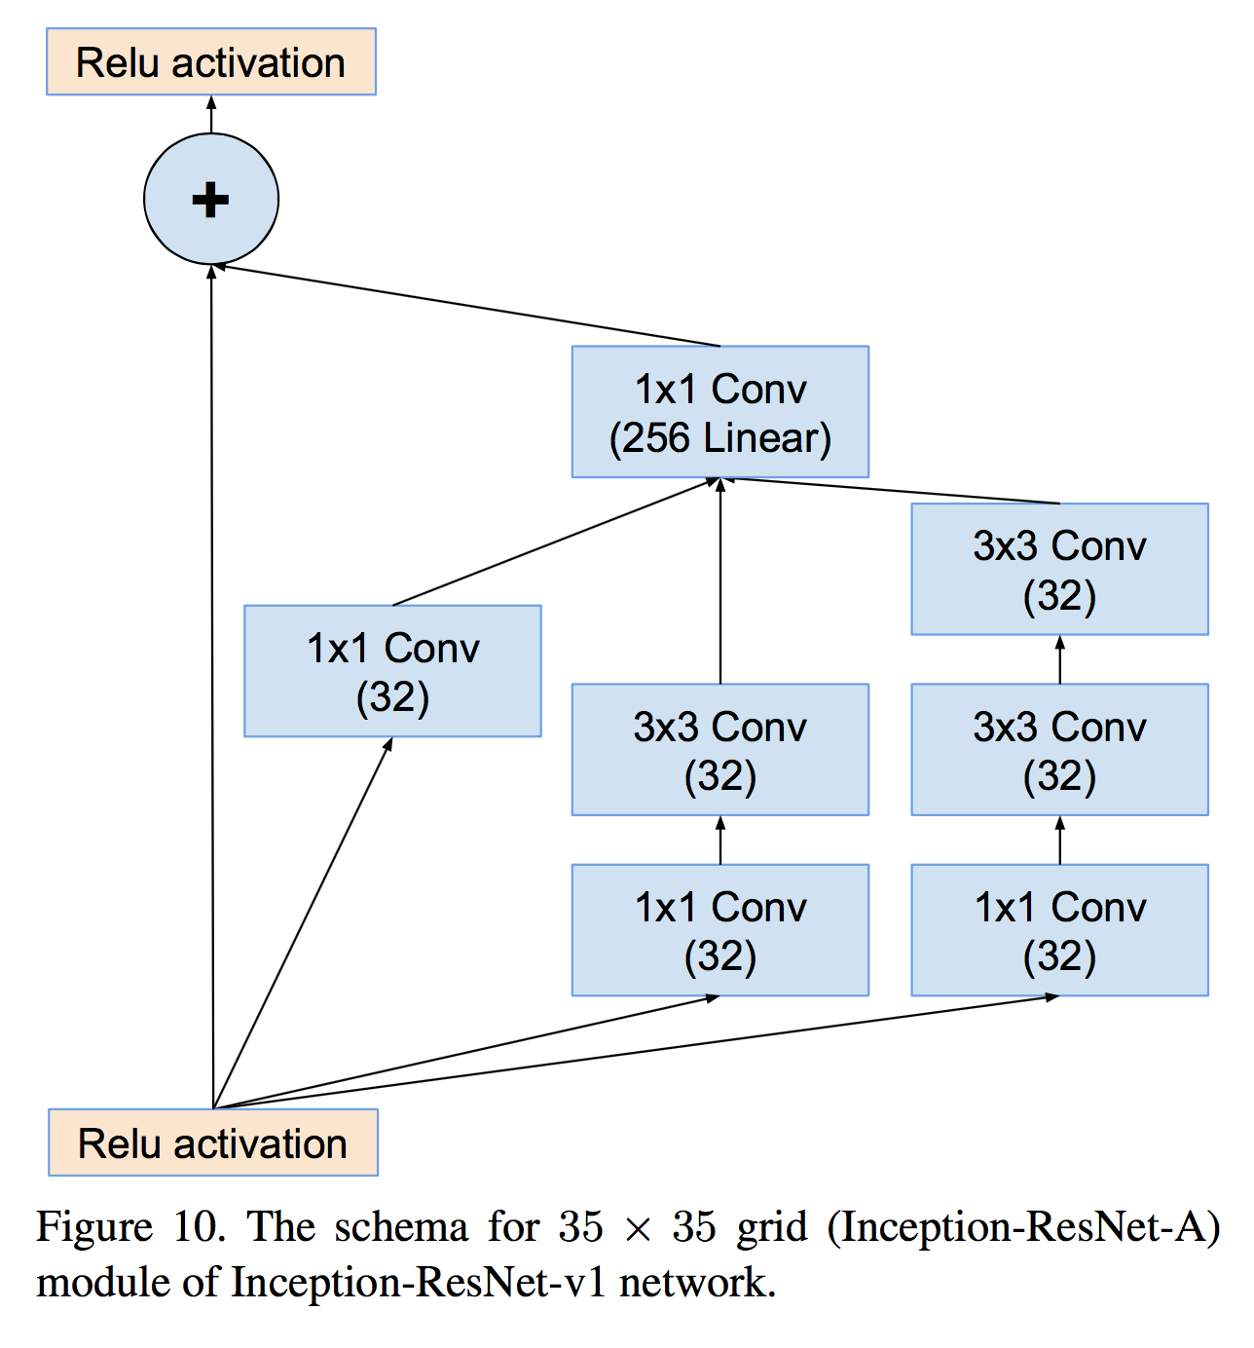
Inception-ResNet-v1

Slide 56

Inception-ResNet-v1

Slide 57

Inception-ResNet-v1

Slide 58
ResNet

Slide 59
Deep residual networks
152 layers network
1st place on ILSVRM 2015 classification task
1st place on ImageNet detection
1st place on ImageNet localization
1st place on COCO detection
1st place on COCO segmentation

Slide 60
Deeper Network?
Is deeper network always better?
What about vanishing/exploding gradients?
Better initialization methods / batch normalization / ReLU
Any other problems?
Overfitting?
Degradation problem: more depth but lower performance

Slide 61


Degeneration problem
CiFAR 100 Dataset
ImageNet

Slide 62

Residual learning building block

Slide 63


Residual learning building block
y
ReLU
+
y
conv2d
y
ReLU
y
conv2d
x

Slide 64
Why residual?
We hypothesize that it is easier to optimize the residual mapping than to optimize the original, unreferenced mapping.
Shortcut connections are used.

Slide 65
Why residual?
“The extremely deep residual nets are easy to optimize. “
“The deep residual nets can easily enjoy accuracy gains from greatly increased depth, producing results substantially better than previous networks. “

Slide 66



Residual mapping
Basic residual mapping (same dim.)
“But we will show by experiments that the identity mapping is sufficient for addressing the degradation problem and is economical, and thus W is only used when matching dimensions.”
Basic residual mapping (different dim.)

Slide 67

Deep residual network

Slide 68


Deeper bottle architecture
Dimension reduction
Convolution
Dimension increasement

Slide 69


Experimental results

Slide 70

Experimental results

